Slide 1

Week 3
Literature Reviews
pcapobianco@kentech.ac.kr

Slide 2
Week 3 agenda
Writing workshop (from PPT 2)
Review Baldwin HW
Literature review
Connectors (grammar)

Slide 3
Reminder
Please upload your proposals ASAP
I will get you some comments on these next Tuesday or Thursday

Slide 4
Reminder 2
1:1 Tutoring hours link in the ANNOUNCEMENTS section of LMS
Please let me know what you want to talk about before coming
On Zoom
30 minutes long

Slide 5
Baldwin reading
Did you read it?

Slide 6
Baldwin paper
Written supplement to the video
Contains more detailed information

Slide 7
BALDWIN READING REVIEW
Identify audience
What journal are you trying to publish in what are the norms (i.e. narrative vs. academic)
Aim for the APPROPRIATE level
Write while you are still researching = writing as experimental
Define the ‘red line’
Red line = rough draft ‘abstract’ of your research
The plan for the paper should be clear from this abstract
Create final versions of figures (graphs, tables, etc.)
Write the Results section
Results should follow figures
Write the Methods section according to journal standards
Concise and detailed
Write the introduction
* Write the LAST paragraph of the introduction
Identify the words and concepts that require elaboration
Write a literature review based on these concepts (either in intro or lit review section)
Write Discussion
Motivation and conclusions from your data
Acknowledge the holes/problems in your data
References

Slide 8
BALDWIN ON EDITING
Become a good editor
Erase the memory of what you wrote to better see grammar errors
“Men in Black” strategy = pretend you are not looking at your own work
New font
New paper
Print out
Etc
Edit the work of others
Classmates
Undergraduate students
Etc

Slide 9
Questions on Baldwin?

Slide 10
Introduction to writing workshop
Not sure if you will like this, but let’s try it
If you don’t find it useful, we stop doing it

Slide 11
Writing Workshop
Interactive community writing activity
Learn a simple writing or grammar point
Practice it
Practice writing
Read out loud = reading and speaking practice
Get familiar with classmates

Slide 12
Writing Workshop Procedure
Explain grammar or writing feature - 5-10 minutes
Students write 10-15 minutes
Students share 10-15 minutes
Constructive feedback

Slide 13
Today’s point: Narrative vs. academic writing
What is the difference?

Slide 14
Writing workshop activity: Narrative writing vs academic writing
NARRATIVE writing vs ACADEMIC writing
NARRATIVE = personal stories, commentaries, experiences
ACADEMIC = anything written for school or educational contexts

Slide 15
STYLE: NARRATIVE VS ACADEMIC
Narrative = conversational, first person (use of I), organized in sequence, non-technical vocab, no serious references, subjective
Academic = formal, structured around ideas (what we learned today), technical vocab, uses references and concepts, objective

Slide 16
Example of narrative paragraph: What are the ‘narrative’ features of this para? Discuss pairs.
“I was born in New York City to immigrant parents from Italy and Poland. As a child, I really enjoyed playing baseball with my school friends. In junior high school, I was really good at baseball. I played second base, and in one game I stopped six balls and throw out the batters. Everyone was super impressed! But when I got into high school, I stopped playing baseball. I wasn’t a good student actually. Instead of focusing on my studies and athletics, I played a lot of video games and tried to find a girlfriend. I feel like I wasted a lot of time. Then, right before I went to college, I became a serious student again. My last year of high school, I got good grades and then got into a pretty good college. And now I am here, so I guess things turned out okay. Like the title of Shakespeare said ‘all’s well that ends well.’”

Slide 17
Example of narrative paragraph: What are the ‘narrative’ features of this para? Discuss pairs.
“I was born in New York City to immigrant parents from Italy and Poland. As a child, I really enjoyed playing baseball with my school friends. In junior high school, I was really good at baseball. I played second base, and in one game I stopped six balls and throw out the batters. Everyone was super impressed! But when I got into high school, I stopped playing baseball. I wasn’t a good student actually. Instead of focusing on my studies and athletics, I played a lot of video games and tried to find a girlfriend. I feel like I wasted a lot of time. Then, right before I went to college, I became a serious student again. My last year of high school, I got good grades and then got into a pretty good college. And now I am here, so I guess things turned out okay. Like the title of Shakespeare said ‘all’s well that ends well.’”

Slide 18
NARRATIVE FEATURES
Use of first-person (“I”)
Academic writing uses pronouns too but less frequently
Use of informal words (I got, I got into, super, really)
Academic uses more formal and literary words
Use of informal connectors (then)
More formal and literary
Generally short sentences lacking long noun phrases

Slide 19
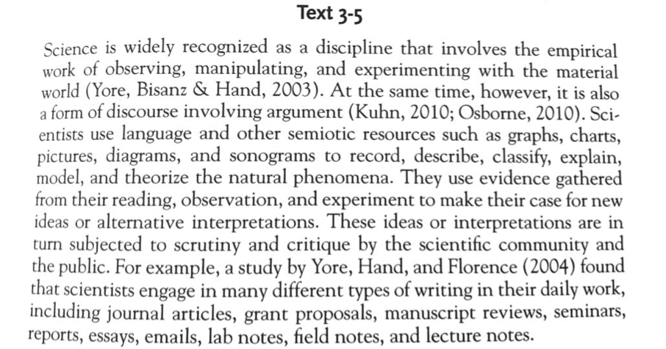
Academic writing paragraph: What are the more academic features? In pairs

Slide 20
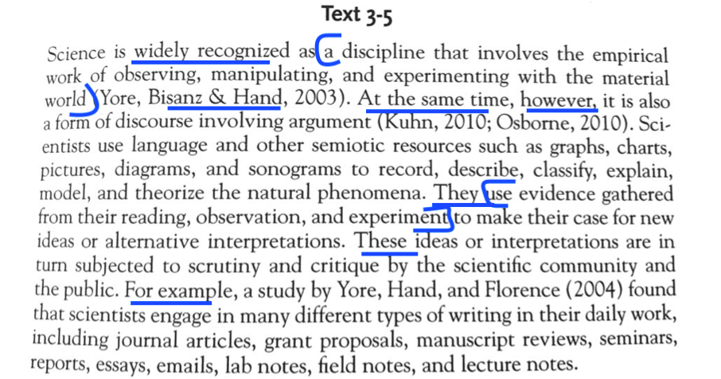
Academic writing paragraph: What are the more academic features?

Slide 21
Academic writing features
Academic writing usually uses OBJECTIVE PROSE
No use of first person
Abstractions of groups (scientists; they; these)
Formal connectors (however (not but); for example)
Long noun phrases to convey dense meaning
Formal vocabulary (widely recognized)

Slide 22
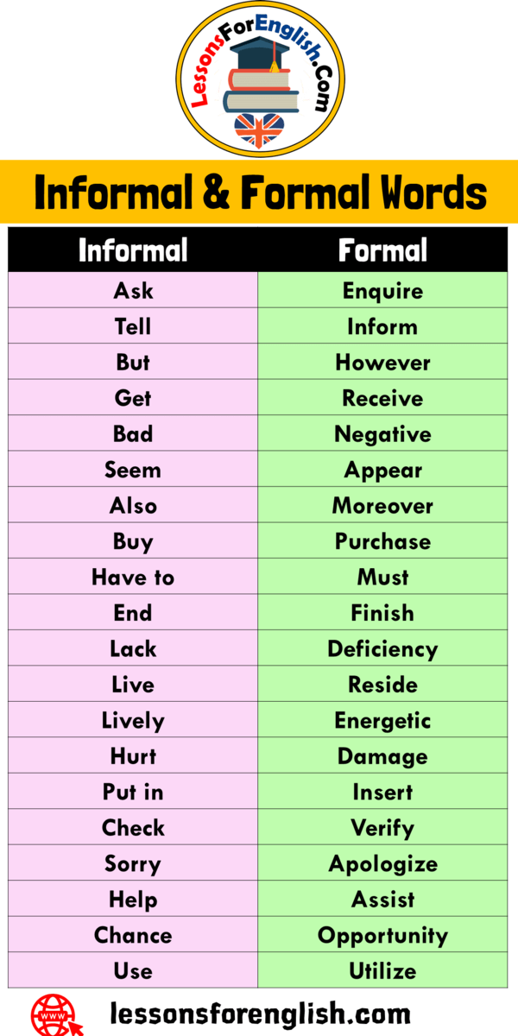
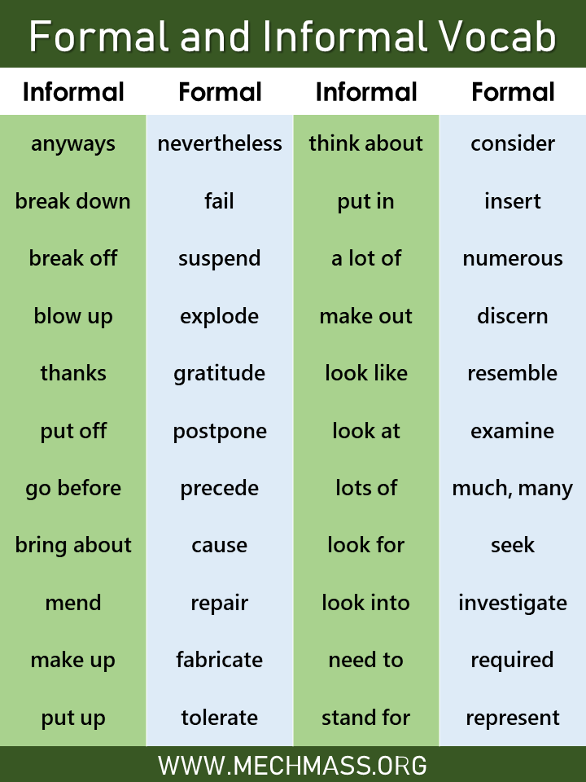
Examples of non-academic and academic vocabulary

Slide 23
QUESTIONS?

Slide 24
Writing workshop activity PLEASE WRITE AND UPLOAD LATER - Don’t worry about spelling, etc.
Write about your personal academic background
This might include…
Where did you go to high school?
What did you study as an undergraduate?
What memorable experiments did you?
Research, grants, jobs, etc.?
Or other things too

Slide 25
Time for writing in class
Write well NOT perfectly
This is NOT ‘free writing’

Slide 26
Reading and sharing
Read your story to your group mates
Group mates consider:
What features of narrative writing does the speaker use?
Is the writing in a casual tone that is common in narrative?
Does the speaker write in the first person?
Is it easy to understand? Or are there too many technical terms or vocabulary?
Is it interesting? (narrative should be interesting =])
Can you feel the subjective aspects of the writing (vs. objective)?

Slide 27
Literature Review Discussion
What is the purpose of a literature review?
What should you do in a literature review?

Slide 28
LITERATURE REVIEW
What is a literature review?
A literature review is a "comprehensive study and interpretation of literature that addresses a specific topic" (Aveyard, 2010)
STUDY = you are carefully reviewing the a body of research and its findings
INTERPRETATION = you are interpreting them relative to your field (are these good studies, are there problems with them, can I do them better, were there problems with the methods, etc.)
Provide a ‘shopping list of past papers’ (Ch 15 HW)
Usually comes in the Introduction or immediately after Introduction [depends on journal standards]

Slide 29
LITERATURE REVIEW
The literature review should contextualize your specific research relative to specific findings by other researchers
Discuss what research others have done
Discuss limitations of previous research (things we don’t know, things that are inaccurate, things that are old, etc.)
Discuss how your study can fill this gap
Only cover as much as necessary!
Unless you are writing a review paper, you do not need to cover absolutely everything

Slide 30
LITERATURE REVIEW: LITERATURE REVIEWS OFTEN ANSWER…
What are the seminal works on the topic?
What progress has been made since these seminal works?
What are the most relevant recent works?
What are the achievements and limits of previous works?
What gap do these limitations reveal?
How does my work fill this gap.

Slide 31
BUT…
Each literature review is unique to the topic, journal, etc.

Slide 32
LITERATURE REVIEW: FROM HOMEWORK
Review of the literature (Ch 15)
Pay attention to what sentences do what (p4-5)
Pay attention to tenses (p5)
Pay attention to the way different authors are referred to and what different elements emphasize(p5)
What tenses to use (p7)
Reducing redundancy (p10)

Slide 33
SAMPLE LITERATURE REVIEW
Angelidou
Nelson et al.
Introduction section
Section 3: Prostate cancer epidemiology

Slide 34
SUMMARIES
These studies are taking one theme/topic and explaining the studies surrounding that theme
Example: The non-genetic influence on the development of prostate cancer
They then explain the studies that have been conducted in this area
1) Asian men do not get prostate cancer as much as western men, BUT when Asian men live in western cultures for some time, they do develop prostate cancer at similar rates
-> Here are the evidence and studies showing this
2) Studies show that history of sexually trasnmitted diseaes was correllated with PC
-> Here is the evidence and studies showing it
3) Inflammation is suspected to cause PC but not conclusive

Slide 35
ACTIVITY
Find an article published in a recent journal in each of your group members’ tracks
Identify: what is going on in this literature review?
What is happening in it?
Compare them

Slide 36
GROUP DISCUSSION

Slide 37
Homework
Read “Writing a literature review” 126-144
Uploaded but only reference, no need to read
Read “Review of the literature” 267-275
Don’t do the exercises, just read the chapter
Revise proposals based on comments
Specifically discuss if/how you will address my comments
Upload them to LMS
Bring to class TWO articles in your research area/track/etc. that have literature reviews

